Slide 1
Lecture 21: Clustering (Part 2) – Mixture Models and the EM Algorithm
Instructor: Yang Xu

Slide 2
Outline
Gaussian distribution
Mixture of gaussians
EM (Expectation-Maximization) method

Slide 3
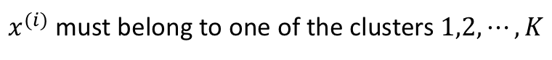
Motivation
K-means make hard assignments to data points:
$x^{(i)}$ must belong to one of the clusters $1,2,⋯,K$
Sometimes, one data point can belong to multiple clusters
Clusters may overlap
Hard assignment may be simplistic
Need a soft assignment: data points belong to clusters with different probabilities

Slide 4
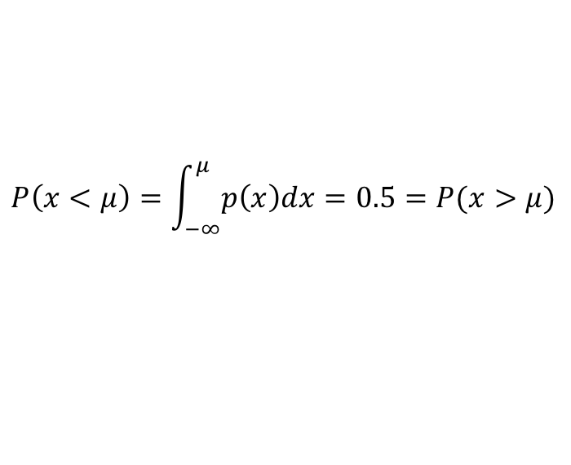
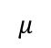
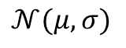
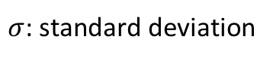
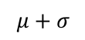
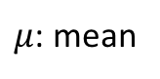
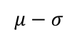
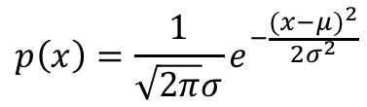
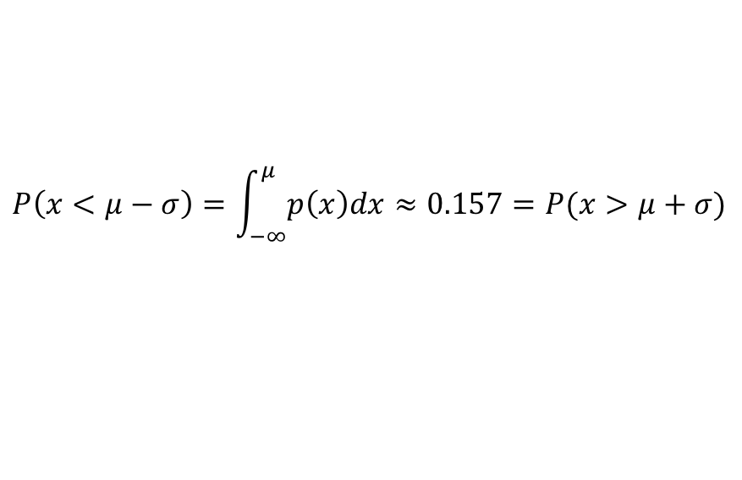
Gaussian (Normal) distribution
1-D (univariate) Gaussian
$$𝒩(μ,σ)$$
$$p\left(x\right)=\frac{1}{\sqrt{2π}σ}e^{−\frac{{(x−μ)}^{2}}{2σ^{2}}}$$
Probability density function (PDF):
$μ$: mean
$σ$: standard deviation
$$P\left(x<μ\right)=\int_{−∞}^{μ}{p\left(x\right)dx}=0.5=P(x>μ)$$
$$P\left(x<μ−σ\right)=\int_{−∞}^{μ}{p\left(x\right)dx}≈0.157=P(x>μ+σ)$$
$$μ−σ$$
$$μ$$
$$μ+σ$$

Slide 5
Gaussian is ubiquitous
In biology, the logarithm of various variables
Measures of size: length, height, weight, …
Blood pressure of adult humans
In finance, the logarithm of change rates
Price indices
Stock market indices
Tend to have a Gaussian distribution
In linguistics, the logarithm of
Word frequency
Sentence length
Many scores
Z-scores, t-scores
Bell curve grading

Slide 6
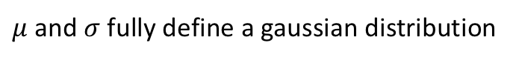

Gaussian model
$μ$ and $σ$ fully define a gaussian distribution
Use them as parameter $θ=(μ,σ)$ to define the model:
suppose each data point is randomly drawn from the distribution
$μ,σ$are unknown, but they can be learned (estimated) from data
Job: find the parameters that best fit the data
What is “best fit”?
→ Maximum Likelihood Estimation (MLE)

Slide 7
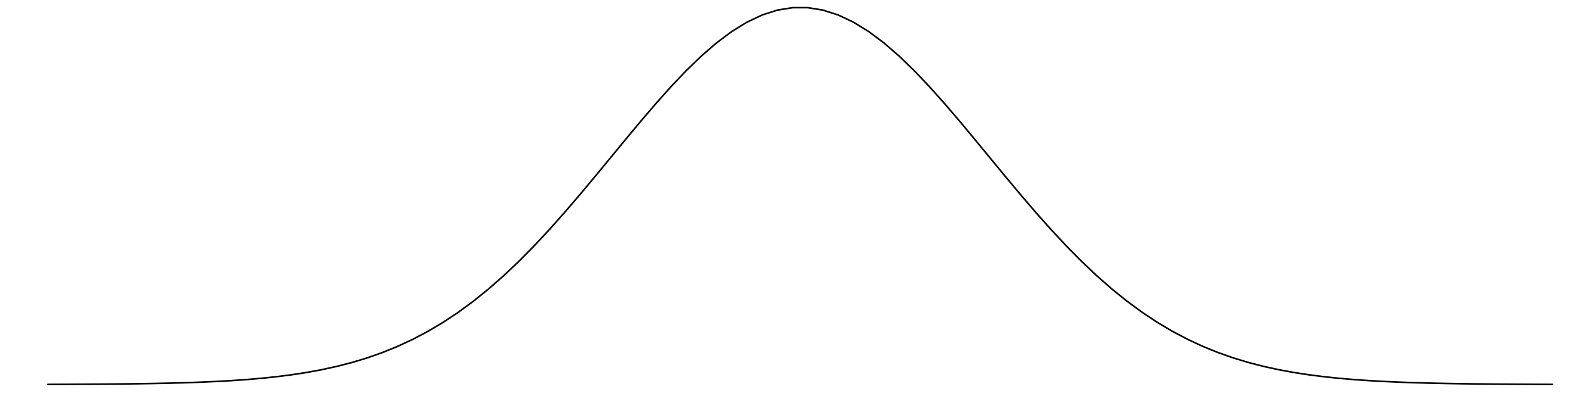

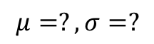
Gaussian model example
Data: weight of Salmon fish.
Assumption: The weight is from a Gaussian distribution
Task: to estimate the $μ,σ$ of Salman
$$μ=?,σ=?$$
Weight (lbs)

Slide 8
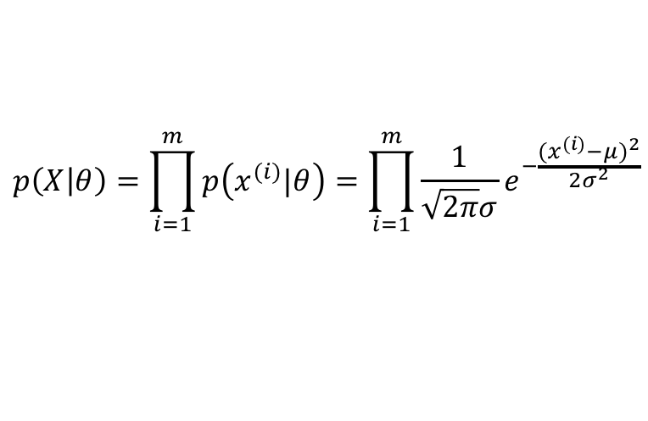
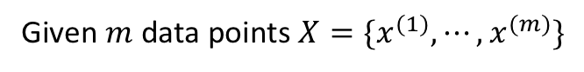
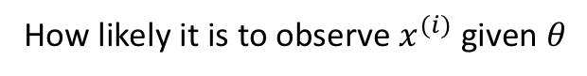
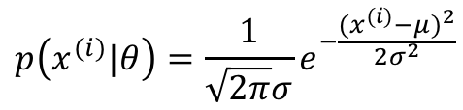
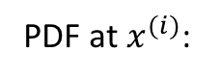
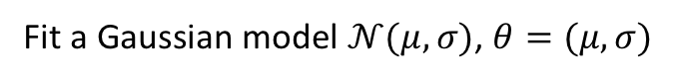
Maximum Likelihood Estimation (MLE)
Given $m$ data points $X=\{x^{(1)},⋯,x^{(m)}\}$
Fit a Gaussian model $𝒩(μ,σ)$, $θ=(μ,σ)$
PDF at $x^{(i)}$:
$$p\left(x^{(i)}|θ\right)=\frac{1}{\sqrt{2π}σ}e^{−\frac{{(x^{(i)}−μ)}^{2}}{2σ^{2}}}$$
How likely it is to observe $x^{(i)}$ given $θ$
Assuming all data points are independent, then the likelihood of observing the whole dataset:
$$p\left(X | θ\right)=\prod_{i=1}^{m}{p\left(x^{(i)}|θ\right)}=\prod_{i=1}^{m}{\frac{1}{\sqrt{2π}σ}e^{−\frac{{(x^{(i)}−μ)}^{2}}{2σ^{2}}}}$$
A good estimation of $θ$ needs to maximize $p\left(X | θ\right)$, the likelihood of data given the paramters

Slide 9
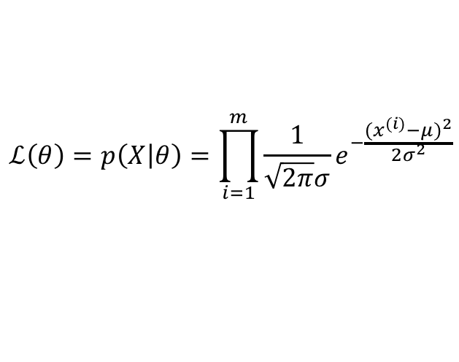
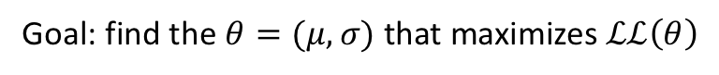
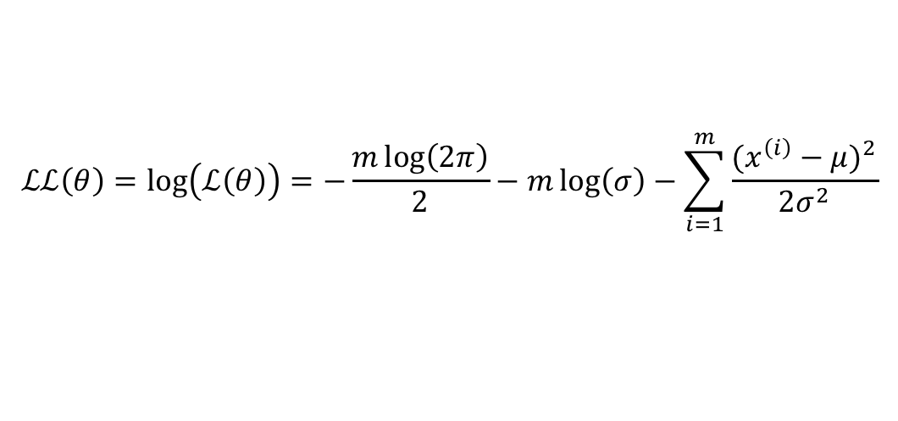
Maximum Likelihood Estimation (MLE) (cont.)
Likelihood function:
$$ℒ\left(θ\right)=p\left(X | θ\right)=\prod_{i=1}^{m}{\frac{1}{\sqrt{2π}σ}e^{−\frac{{(x^{(i)}−μ)}^{2}}{2σ^{2}}}}$$
It is easier to work with log-likelihood:
$$ℒℒ\left(θ\right)=\log\left(ℒ\left(θ\right)\right)=−\frac{m\log\left(2π\right)}{2}−m\log\left(σ\right)−\sum_{i=1}^{m}{\frac{{(x^{\left(i\right)}−μ)}^{2}}{2σ^{2}}}$$
Goal: find the $θ=(μ,σ)$ that maximizes $ℒℒ\left(θ\right)$

Slide 10
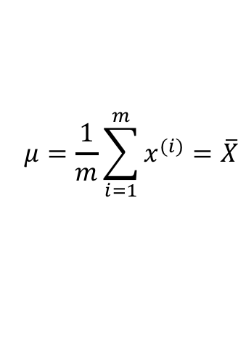
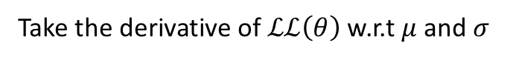
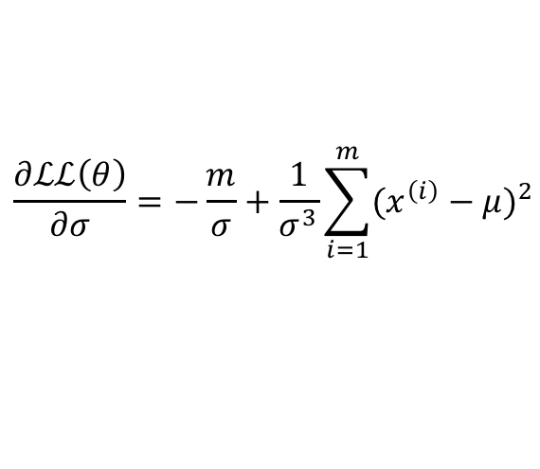
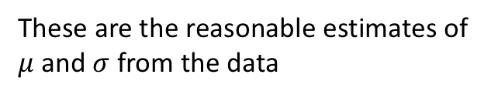
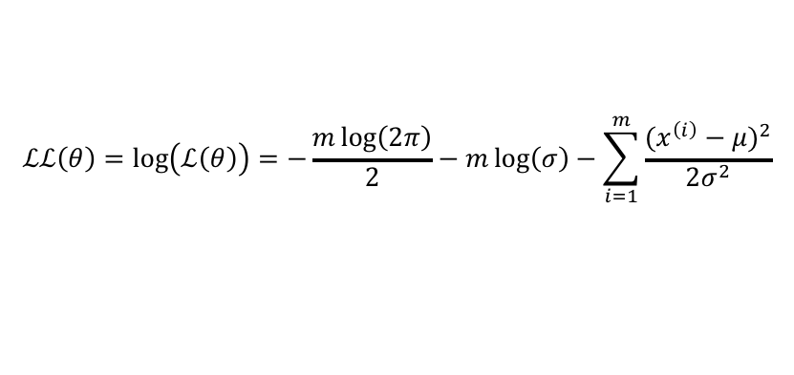
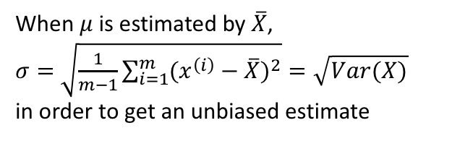
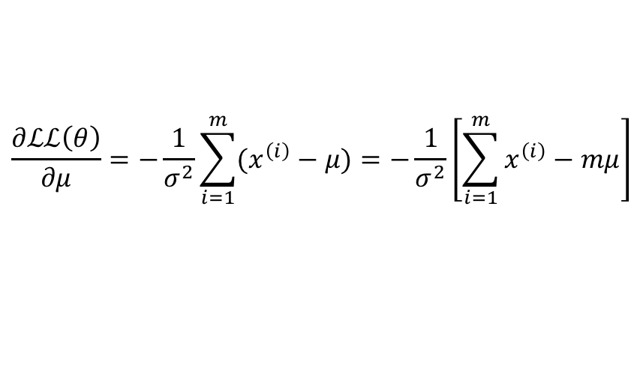
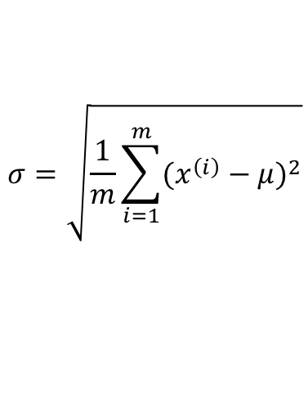
Maximum Likelihood Estimation (MLE) (cont.)
$$ℒℒ\left(θ\right)=\log\left(ℒ\left(θ\right)\right)=−\frac{m\log\left(2π\right)}{2}−m\log\left(σ\right)−\sum_{i=1}^{m}{\frac{{(x^{\left(i\right)}−μ)}^{2}}{2σ^{2}}}$$
Take the derivative of $ℒℒ\left(θ\right)$ w.r.t $μ$ and $σ$
$$\frac{∂ℒℒ\left(θ\right)}{∂μ}=−\frac{1}{σ^{2}}\sum_{i=1}^{m}{(x^{\left(i\right)}−μ)}=−\frac{1}{σ^{2}}\left[\sum_{i=1}^{m}{x^{\left(i\right)}}−mμ\right]$$
$$\frac{∂ℒℒ\left(θ\right)}{∂σ}=−\frac{m}{σ}+\frac{1}{σ^{3}}\sum_{i=1}^{m}{{(x^{\left(i\right)}−μ)}^{2}}$$
$ℒℒ\left(θ\right)$ has extreme values when $\frac{∂ℒℒ\left(θ\right)}{∂μ}=0$ and $\frac{∂ℒℒ\left(θ\right)}{∂σ}=0$
When $μ$ is estimated by $\overline{X}$,
$σ=$ $\sqrt{\frac{1}{m−1}\sum_{i=1}^{m}{{(x^{\left(i\right)}−\overline{X})}^{2}}}=\sqrt{Var(X)}$
in order to get an unbiased estimate
$$σ=\sqrt{\frac{1}{m}\sum_{i=1}^{m}{{(x^{\left(i\right)}−μ)}^{2}}}$$
$$μ=\frac{1}{m}\sum_{i=1}^{m}{x^{(i)}}=\overline{X}$$
Mean of data
(sample mean)
Variance of data
(sample variance)
These are the reasonable estimates of
$μ$ and $σ$ from the data

Slide 11
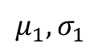
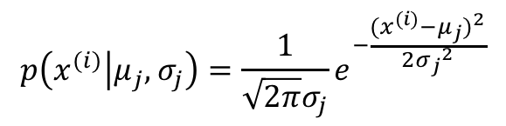
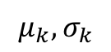
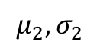
Mixture of Gaussians
Previous example has the assumption that data are drawn from one Gaussian distribution $𝒩(μ,σ)$
What if there are multiple Gaussian distributions: $𝒩(μ_{1},σ_{1})$, $𝒩(μ_{2},σ_{2})$, …, $𝒩(μ_{k},σ_{k})$
How do we generate the data?
Step 1: Draw from $k$ distributions with probabilities $Q_{1},Q_{2},⋯,Q_{k}$
$$μ_{1},σ_{1}$$
$$μ_{2},σ_{2}$$
…
$$μ_{k},σ_{k}$$
Step 2: Suppose distribution $j$ is chosen, draw a data point from $𝒩(μ_{j},σ_{j})$
$$p\left(x^{(i)} | μ_{j},σ_{j}\right)=\frac{1}{\sqrt{2π}σ_{j}}e^{−\frac{{(x^{(i)}−μ_{j})}^{2}}{2{σ_{j}}^{2}}}$$

Slide 12
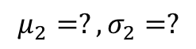
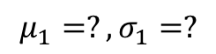
Example of 2 Gaussians
Weights of two kinds of fish: Salmon & Tuna fish
$$μ_{1}=?, σ_{1}=?$$
$$μ_{2}=?, σ_{2}=?$$
Weight (lbs)

Slide 13
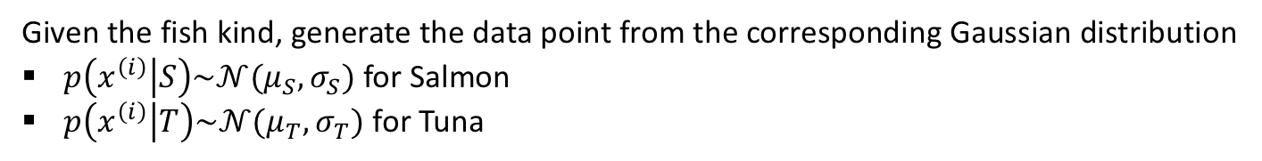
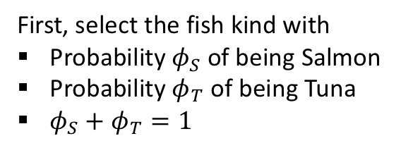
How a data point is generated
A data point $x^{(i)}$ is generated according to the following process:
First, select the fish kind with
Probability $φ_{S}$ of being Salmon
Probability $φ_{T}$ of being Tuna
$φ_{S}+φ_{T}=1$
Given the fish kind, generate the data point from the corresponding Gaussian distribution
$p\left(x^{\left(i\right)} | S\right)\sim 𝒩(μ_{S},σ_{S})$ for Salmon
$p\left(x^{\left(i\right)} | T\right)\sim 𝒩(μ_{T},σ_{T})$ for Tuna

Slide 14
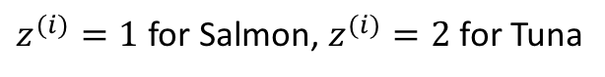
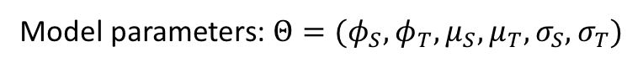
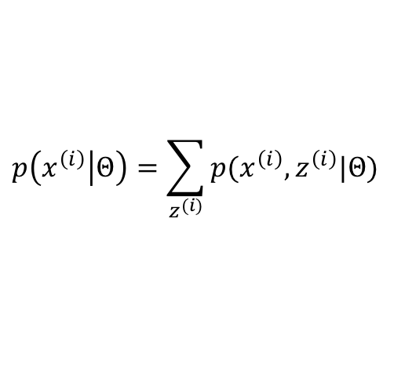
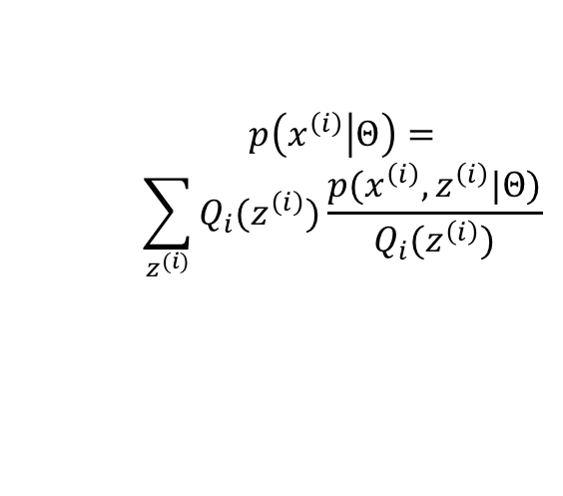
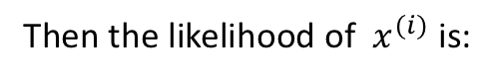
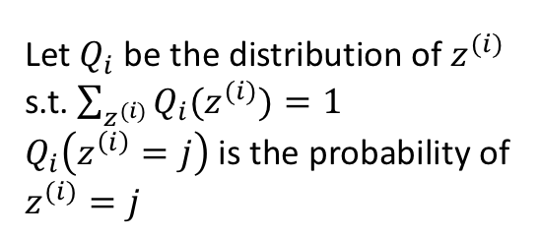
Introduce latent (unobserved) variable
Model parameters: $Θ=(φ_{S},φ_{T},μ_{S},μ_{T},σ_{S},σ_{T})$
Parameters for mixture probabilities
Parameters for each Gaussian distribution
For each data point $x^{(i)}$, we don’t know if it is a Salmon or Tuna
Let $z^{(i)}$ be the latent random variable indicating which Gaussian distribution $x^{(i)}$ is from
$z^{(i)}=1$ for Salmon, $z^{(i)}=2$ for Tuna
Rewrite the likelihood
Then the likelihood of $x^{(i)}$ is:
Let $Q_{i}$ be the distribution of $z^{(i)}$
s.t. $\sum_{z^{(i)}}{Q_{i}(z^{(i)})}=1$
$Q_{i}\left(z^{\left(i\right)}=j\right)$ is the probability of $z^{(i)}=j$
$$p\left(x^{\left(i\right)} | Θ\right)=$$
$$\sum_{z^{(i)}}{Q_{i}(z^{\left(i\right)})\frac{p(x^{\left(i\right)},z^{\left(i\right)}|Θ)}{Q_{i}(z^{\left(i\right)})}}$$
$$p\left(x^{\left(i\right)} | Θ\right)=\sum_{z^{(i)}}{p(x^{\left(i\right)},z^{\left(i\right)}|Θ)}$$

Slide 15
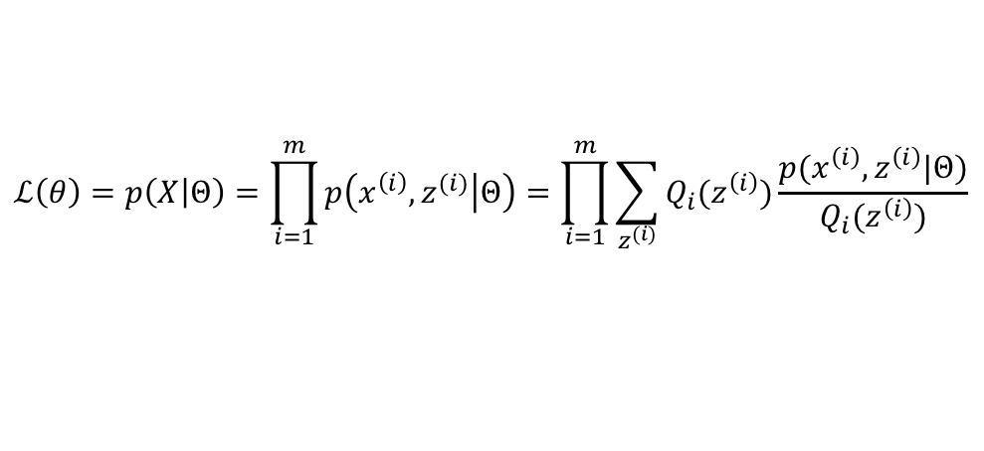
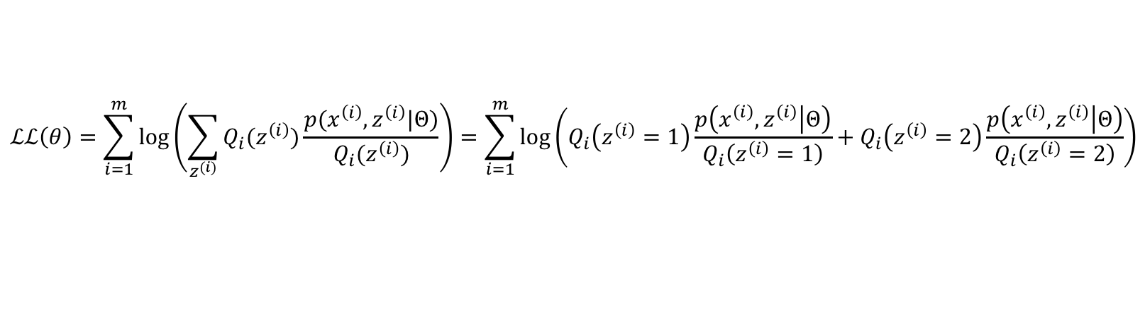
Log likelihood of data
$$ℒ\left(θ\right)=p\left(X | Θ\right)=\prod_{i=1}^{m}{p\left(x^{\left(i\right)},z^{(i)} | Θ\right)}=\prod_{i=1}^{m}{\sum_{z^{(i)}}{Q_{i}(z^{\left(i\right)})\frac{p(x^{\left(i\right)},z^{\left(i\right)}|Θ)}{Q_{i}(z^{\left(i\right)})}}}$$
The likelihood of the whole data:
$$ℒℒ\left(θ\right)=\sum_{i=1}^{m}{log\left(\sum_{z^{(i)}}{Q_{i}(z^{\left(i\right)})\frac{p(x^{\left(i\right)},z^{\left(i\right)}|Θ)}{Q_{i}(z^{\left(i\right)})}}\right)}=\sum_{i=1}^{m}{log\left(Q_{i}\left(z^{\left(i\right)}=1\right)\frac{p\left(x^{\left(i\right)},z^{\left(i\right)} | Θ\right)}{Q_{i}\left(z^{\left(i\right)}=1\right)}+Q_{i}\left(z^{\left(i\right)}=2\right)\frac{p\left(x^{\left(i\right)},z^{\left(i\right)} | Θ\right)}{Q_{i}\left(z^{\left(i\right)}=2\right)}\right)}$$
Log likelihood:
It is difficult to take the derivative of $ℒℒ\left(θ\right)$ w.r.t. $φ_{S},φ_{T},μ_{S},μ_{T},σ_{S},σ_{T}$, and solve them analytically
Solution: Instead of maximizing $ℒℒ\left(θ\right)$, we can maximize the lower bound of $ℒℒ\left(θ\right)$
Idea: Find some expression $E$, s.t. $ℒℒ\left(θ\right)≥E$. When we maximize $E$, $ℒℒ\left(θ\right)$ is also maximized.
$E$ should have a form that is easier to calculate derivatives

Slide 16
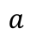
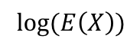
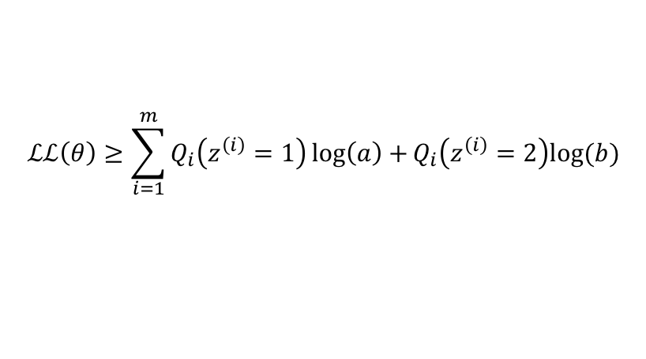
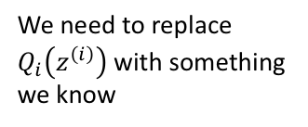













Find the lower bound of $ℒℒ\left(θ\right)$
Let $a,b$ be two values of a random variable $X$
$$ℒℒ\left(θ\right)=\sum_{i=1}^{m}{log\left(Q_{i}\left(z^{\left(i\right)}=1\right)\frac{p\left(x^{\left(i\right)},z^{\left(i\right)} | Θ\right)}{Q_{i}\left(z^{\left(i\right)}=1\right)}+Q_{i}\left(z^{\left(i\right)}=2\right)\frac{p\left(x^{\left(i\right)},z^{\left(i\right)} | Θ\right)}{Q_{i}\left(z^{\left(i\right)}=2\right)}\right)}$$
$$a$$
$$b$$
Then $Q_{i}\left(z^{\left(i\right)}=1\right)a+Q_{i}\left(z^{\left(i\right)}=2\right)b$ is the expectation of $E(X)$
Probability
Probability
Because log(x) is convex
$$\log\left(E\left(X\right)\right)≥E(log⁡(X))$$
$$ℒℒ\left(θ\right)≥\sum_{i=1}^{m}{Q_{i}\left(z^{\left(i\right)}=1\right)\log\left(a\right)+}Q_{i}\left(z^{\left(i\right)}=2\right)log⁡(b)$$
$$log⁡(b)$$
$$log⁡(x)$$
$$log⁡(E\left(X\right))$$
$$E\left(log⁡(X)\right)$$
$$=\sum_{i=1}^{m}{\sum_{z^{(i)}}{Q_{i}\left(z^{\left(i\right)}\right)log⁡\left(\frac{p(x^{\left(i\right)},z^{\left(i\right)}|Θ)}{Q_{i}(z^{\left(i\right)})}\right)}}$$
We need to replace $Q_{i}\left(z^{\left(i\right)}\right)$ with something we know
$$log⁡(a)$$
Jensen’s inequality: $f(E(X))≥E(f\left(X\right))$, when $f$ is convex
$$a$$
$$E(X)$$
$$b$$

Slide 17










How to estimate $Q_{i}$
$$ℒℒ\left(θ\right)≥\sum_{i=1}^{m}{\sum_{z^{(i)}}{Q_{i}\left(z^{\left(i\right)}\right)log⁡\left(\frac{p(x^{\left(i\right)},z^{\left(i\right)}|Θ)}{Q_{i}(z^{\left(i\right)})}\right)}}$$
$Q_{i}(z^{\left(i\right)})$ is unknown, but we can guess it after observing $x^{\left(i\right)}$
I.e., after observing a data point $x^{\left(i\right)}$, we can “guess” which distribution it is from
$$\frac{1}{\sqrt{2π}σ_{S}}e^{−\frac{{(x^{(i)}−μ_{S})}^{2}}{2{σ_{S}}^{2}}}$$
A reasonable way to guess:
If $x^{(i)}$ is drawn from Salmon, then the likelihood of $x^{(i)}$ is
$$p\left(x^{\left(i\right)} | S\right)p\left(S\right)=p(x^{\left(i\right)}|μ_{S},σ_{S})φ_{S}$$
If $x^{(i)}$ is drawn from Tuna, then the likelihood of $x^{(i)}$ is
$$p\left(x^{\left(i\right)} | T\right)p\left(T\right)=p(x^{\left(i\right)}|μ_{T},σ_{T})φ_{T}$$
Then the chance of $x^{(i)}$ being Salmon is:
The chance of $x^{(i)}$ being Tuna is:
$$p\left(S|x^{\left(i\right)}\right)=\frac{p\left(x^{\left(i\right)} | S\right)p(S)}{p\left(x^{\left(i\right)} | S\right)p\left(S\right)+p\left(x^{\left(i\right)} | T\right)p(T)}$$
$$p\left(T|x^{\left(i\right)}\right)=\frac{p\left(x^{\left(i\right)} | T\right)p(T)}{p\left(x^{\left(i\right)} | S\right)p\left(S\right)+p\left(x^{\left(i\right)} | T\right)p(T)}$$
Posterior, $w_{S}^{(i)}$
Posterior, $w_{T}^{(i)}$

Slide 18





New form of Log-likelihood function
$$ℒℒ\left(θ\right)≥\sum_{i=1}^{m}{\sum_{z^{\left(i\right)}}{Q_{i}\left(z^{\left(i\right)}\right)\log\left(\frac{p\left(x^{\left(i\right)},z^{\left(i\right)} | Θ\right)}{Q_{i}\left(z^{\left(i\right)}\right)}\right)}}=\sum_{i=1}^{m}{w_{S}^{(i)}\log\left(\frac{p\left(x^{\left(i\right)},z^{\left(i\right)}=1 | Θ\right)}{w_{S}^{(i)}}\right)+w_{T}^{(i)}\log\left(\frac{p\left(x^{\left(i\right)},z^{\left(i\right)}=2 | Θ\right)}{w_{T}^{(i)}}\right)}$$
$$=ℒℒ′\left(θ\right)$$
$$p\left(x^{\left(i\right)},z^{\left(i\right)}=1 | Θ\right)=p\left(x^{\left(i\right)} | μ_{S},σ_{S}\right)φ_{S}=\frac{φ_{S}}{\sqrt{2π}σ_{S}}e^{−\frac{{(x^{(i)}−μ_{S})}^{2}}{2σ_{S}^{2}}}$$
$$p\left(x^{\left(i\right)},z^{\left(i\right)}=2 | Θ\right)=p\left(x^{\left(i\right)} | μ_{T},σ_{T}\right)φ_{T}=\frac{φ_{T}}{\sqrt{2π}σ_{T}}e^{−\frac{{(x^{(i)}−μ_{T})}^{2}}{2σ_{T}^{2}}}$$
Treating $w_{S}$ and $w_{T}$ as known, the derivatives of $ℒℒ′\left(θ\right)$ is much easier to calculate
$$\left\lfloor ℒℒ\left(θ\right)\right\rfloor =ℒℒ^{′\left(θ\right)}=\sum_{i=1}^{m}{w_{S}^{(i)}\log\left(\frac{φ_{S}}{w_{S}^{(i)}\sqrt{2π}σ_{S}}e^{−\frac{{(x^{(i)}−μ_{S})}^{2}}{2σ_{S}^{2}}}\right)+w_{T}^{(i)}\log\left(\frac{φ_{T}}{w_{T}^{(i)}\sqrt{2π}σ_{T}}e^{−\frac{{(x^{(i)}−μ_{T})}^{2}}{2σ_{T}^{2}}}\right)}$$

Slide 19














Maximizing $ℒℒ′\left(θ\right)$
$$\left\lfloor ℒℒ\left(θ\right)\right\rfloor =ℒℒ^{′\left(θ\right)}=\sum_{i=1}^{m}{w_{S}^{(i)}\log\left(\frac{φ_{S}}{w_{S}^{(i)}\sqrt{2π}σ_{S}}e^{−\frac{{(x^{(i)}−μ_{S})}^{2}}{2σ_{S}^{2}}}\right)+w_{T}^{(i)}\log\left(\frac{φ_{T}}{w_{T}^{(i)}\sqrt{2π}σ_{T}}e^{−\frac{{(x^{(i)}−μ_{T})}^{2}}{2σ_{T}^{2}}}\right)}$$
$$\frac{∂ℒℒ′\left(θ\right)}{∂μ_{S}}=\sum_{i=1}^{m}{\frac{∂}{∂μ_{S}}\left[w_{S}^{(i)}\log\left(\frac{φ_{S}}{\sqrt{2π}σ_{S}}e^{−\frac{{(x^{(i)}−μ_{S})}^{2}}{2σ_{S}^{2}}}\right)\right]=\sum_{i=1}^{m}{w_{S}^{\left(i\right)}(x^{(i)}−μ_{S})}}=0$$
$$μ_{S}=\frac{\sum_{i=1}^{m}{w_{S}^{\left(i\right)}x^{(i)}}}{\sum_{i=1}^{m}{w_{S}^{\left(i\right)}}}$$
$$\frac{∂ℒℒ′\left(θ\right)}{∂σ_{S}}=\sum_{i=1}^{m}{\frac{∂}{∂σ_{S}}\left[w_{S}^{(i)}\log\left(\frac{φ_{S}}{\sqrt{2π}σ_{S}}e^{−\frac{{(x^{(i)}−μ_{S})}^{2}}{2σ_{S}^{2}}}\right)\right]=\sum_{i=1}^{m}{w_{S}^{\left(i\right)}[{\left(x^{\left(i\right)}−μ_{S}\right)}^{2}−σ_{S}^{2}]}}=0$$
$$σ_{S}^{2}=\frac{\sum_{i=1}^{m}{w_{S}^{\left(i\right)}{\left(x^{\left(i\right)}−μ_{S}\right)}^{2}}}{\sum_{i=1}^{m}{w_{S}^{\left(i\right)}}}$$
Find the terms that only depends on $φ_{S}$ and $φ_{T}$
$φ_{S}$ and $φ_{T}$ cannot take any value
Under constraint: $φ_{S}+φ_{T}=1$
$$ℒℒ′\left(θ\right)=\sum_{i=1}^{m}{w_{S}^{(i)}\log\left(φ_{S}\right)+w_{T}^{(i)}\log\left(φ_{T}\right)}$$
$$ℒ\left(φ_{S}\right)=\left(\sum_{i=1}^{m}{w_{S}^{(i)}\log\left(φ_{S}\right)+w_{T}^{(i)}\log\left(φ_{T}\right)}\right)+β(φ_{S}+φ_{T}−1)$$
Construct a Lagrangian:
$$φ_{S}=\frac{\sum_{i=1}^{m}{w_{S}^{(i)}}}{−β}$$
$$φ_{T}=\frac{\sum_{i=1}^{m}{w_{T}^{(i)}}}{−β}$$
$$−β=\sum_{i=1}^{m}{\left(w_{S}^{\left(i\right)}+w_{T}^{\left(i\right)}\right)}=m$$
$$\frac{∂ℒ\left(φ_{S}\right)}{∂φ_{S}}=\frac{\sum_{i=1}^{m}{w_{S}^{(i)}}}{φ_{S}}+β=0$$

Slide 20









Solutions of maximizing $ℒℒ′\left(θ\right)$
$$μ_{S}=\frac{\sum_{i=1}^{m}{w_{S}^{\left(i\right)}x^{(i)}}}{\sum_{i=1}^{m}{w_{S}^{\left(i\right)}}}$$
$$μ_{T}=\frac{\sum_{i=1}^{m}{w_{T}^{\left(i\right)}x^{(i)}}}{\sum_{i=1}^{m}{w_{T}^{\left(i\right)}}}$$
Repeatedly update all parameters,
$φ_{S},φ_{T},μ_{S},μ_{T},σ_{S},σ_{T}$until convergence
$$σ_{S}^{2}=\frac{\sum_{i=1}^{m}{w_{S}^{\left(i\right)}{\left(x^{\left(i\right)}−μ_{S}\right)}^{2}}}{\sum_{i=1}^{m}{w_{S}^{\left(i\right)}}}$$
$$σ_{T}^{2}=\frac{\sum_{i=1}^{m}{w_{T}^{\left(i\right)}{\left(x^{\left(i\right)}−μ_{T}\right)}^{2}}}{\sum_{i=1}^{m}{w_{T}^{\left(i\right)}}}$$
$$φ_{S}=\frac{\sum_{i=1}^{m}{w_{S}^{(i)}}}{m}$$
$$φ_{T}=\frac{\sum_{i=1}^{m}{w_{T}^{(i)}}}{m}$$
$$w_{S}^{\left(i\right)}=p\left(S|x^{\left(i\right)}\right)=\frac{p\left(x^{\left(i\right)} | S\right)φ_{S}}{p\left(x^{\left(i\right)} | S\right)φ_{S}+p\left(x^{\left(i\right)} | T\right)φ_{T}}$$
In which,
$$w_{T}^{\left(i\right)}=p\left(T|x^{\left(i\right)}\right)=\frac{p\left(x^{\left(i\right)} | S\right)φ_{S}}{p\left(x^{\left(i\right)} | S\right)φ_{S}+p\left(x^{\left(i\right)} | T\right)φ_{T}}$$

Slide 21






E-M (Expectation-Maximization) Algorithm (1-D Gaussian)
Assume the data $\{x^{(i)}\}$ are drawn from k Gaussian distributions with probabilities $φ_{1},φ_{2},⋯,φ_{k}$
Each distribution has parameters $μ_{j},σ_{j} (j=1,2,⋯,k)$
Randomly initialize all parameters $φ_{1},φ_{2},⋯,φ_{k}$ and $μ_{j},σ_{j} (j=1,2,⋯,k)$
Repeat until convergence {
E-step: For each $x^{(i)}$, compute the expectation of which distribution it is from
$$w_{j}^{\left(i\right)}≔p\left(z^{\left(i\right)}=j | x^{\left(i\right)}\right)=\frac{p(x^{\left(i\right)}|μ_{j},σ_{j})φ_{j}}{\sum_{j}{p(x^{\left(i\right)}|μ_{j},σ_{j})φ_{j}}}$$
For $j=1,2,⋯,k$
M-step: Update the parameters (as if $w_{j}^{\left(i\right)}$ is correct) by maximizing the likelihood:
$$μ_{j}≔\frac{\sum_{i=1}^{m}{w_{j}^{\left(i\right)}x^{(i)}}}{\sum_{i=1}^{m}{w_{j}^{\left(i\right)}}}$$
$$σ_{j}^{2}≔\frac{\sum_{i=1}^{m}{w_{j}^{\left(i\right)}{\left(x^{\left(i\right)}−μ_{j}\right)}^{2}}}{\sum_{i=1}^{m}{w_{j}^{\left(i\right)}}}$$
$$φ_{j}≔\frac{\sum_{i=1}^{m}{w_{j}^{(i)}}}{m}$$
For $j=1,2,⋯,k$
}
Weighted average

Slide 22



Compare with K-means
Randomly initialize all k centroids $μ_{1},μ_{2},⋯,μ_{k}$
Repeat until convergence {
E-step: For each $x^{(i)}$, assign it to the closest centroid
$$c^{(i)}≔\arg{\min_{j}{{\left\|x^{(i)}−μ_{j}\right\|}^{2}}}$$
M-step: Update the positions of centroids
$$μ_{j}≔\frac{\sum_{i=1}^{m}{1\{c^{\left(i\right)}=j\}x^{(i)}}}{\sum_{i=1}^{m}{1\{c^{\left(i\right)}=j\} }}$$
}

Slide 23








Demonstration with k = 2, 1-D Gaussian
Random initialization
$$μ_{S}^{1}=\frac{\sum_{i=1}^{m}{w_{S}^{\left(i\right)}x^{(i)}}}{\sum_{i=1}^{m}{w_{S}^{\left(i\right)}}}$$
Salmon:$φ_{S}^{0},μ_{S}^{0},σ_{S}^{0}$
Tuna: $φ_{T}^{0},μ_{T}^{0},σ_{T}^{0}$
M-step
$$μ_{T}^{1}=\frac{\sum_{i=1}^{m}{w_{T}^{\left(i\right)}x^{(i)}}}{\sum_{i=1}^{m}{w_{S}^{\left(i\right)}}}$$
Weight (lbs)
$$w_{S}^{(i)}=0.6$$
These points tend to have larger $w_{S}^{(i)}$
$$w_{T}^{(i)}=0.4$$
These points tend to have larger $w_{T}^{(i)}$
E-step

Slide 24




Demonstration with k = 2, 1-D Gaussian
After 1 iteration
$$φ_{S}^{1},μ_{S}^{1},σ_{S}^{1}$$
$$φ_{T}^{1},μ_{T}^{1},σ_{T}^{1}$$
Weight (lbs)
$$w_{S}^{(i)}=0.75$$
$$w_{T}^{(i)}=0.25$$

Slide 25




Demonstration with k = 2, 1-D Gaussian
After N iterations, all parameters converge
$$φ_{S}^{N},μ_{S}^{N},σ_{S}^{N}$$
$$φ_{T}^{N},μ_{T}^{N},σ_{T}^{N}$$
Weight (lbs)
$$w_{S}^{(i)}=0.77$$
$$w_{T}^{(i)}=0.23$$
This data point is 0.77 chance a Salmon, and 0.23 chance a Tuna
No hard assignment!

Slide 26




What about multivariate Gaussians?
A random vector $X=\left(\begin{aligned}X_{1} \\ ⋮ \\ X_{n}\end{aligned}\right)$ is said to have a multivariate Gaussian distribution
If its probability density function is:
$$p\left(x\right)=\frac{1}{{(2π)}^{n/2}{\left|Σ\right|}^{1/2}}exp⁡\left(−\frac{1}{2}{\left(x−μ\right)}^{T}Σ^{−1}\left(x−μ\right)\right)$$
Mean: $μ∈ℝ^{n}$
Covariance matrix: $Σ$
Property:

Slide 27




Covariance matrix
If $X_{i}$, $Y_{j}$ are a pair of 1-D random variables
Then the covariance is defined as:
$$Cov\left[X_{i},Y_{j}\right]=E\left[\left(X−E\left(X_{i}\right)\right)\left(Y−E\left(Y_{j}\right)\right)\right]=E\left[X_{i}Y_{j}\right]−E(X_{i})E(Y_{j})$$
If $X=\left(\begin{aligned}X_{1} \\ ⋮ \\ X_{n}\end{aligned}\right)$, $Y=\left(\begin{aligned}Y_{1} \\ ⋮ \\ Y_{n}\end{aligned}\right)$are a pair of n-D random variables
Then the covariance matrix $Σ$ is a $n×n$ symmetric matrix
$$Σ=\left[\begin{aligned}Cov[X_{1},Y_{1}] \\ Cov[X_{2},Y_{1}] \\ ⋮ \\ Cov[X_{n},Y_{1}]\end{aligned}\begin{aligned}Cov[X_{1},Y_{2}] \\ Cov[X_{2},Y_{2}] \\ ⋮ \\ Cov[X_{n},Y_{2}]\end{aligned}⋯\begin{aligned}Cov[X_{1},Y_{n}] \\ Cov[X_{2},Y_{n}] \\ ⋮ \\ Cov[X_{n},Y_{n}]\end{aligned}\right]$$
whose $(i,j)$ th entry is $Cov\left[X_{i},Y_{j}\right]$

Slide 28





When n=2, 2-D Gaussian distribution
$$x=\left(\begin{aligned}x_{1} \\ x_{2}\end{aligned}\right)$$
$$μ=\left(\begin{aligned}μ_{1} \\ μ_{2}\end{aligned}\right)$$
$$Σ=\left[\begin{matrix}σ_{1}^{2} & σ_{1}σ_{2} \\ σ_{1}σ_{2} & σ_{2}^{2}\end{matrix}\right]$$
$$p\left(x\right)=\frac{1}{2π{\left|\begin{matrix}σ_{1}^{2} & σ_{1}σ_{2} \\ σ_{1}σ_{2} & σ_{2}^{2}\end{matrix}\right|}^{1/2}}exp⁡\left(−\frac{1}{2}{\left(\begin{aligned}x_{1}−μ_{1} \\ x_{2}−μ_{2}\end{aligned}\right)}^{T}{\left[\begin{matrix}σ_{1}^{2} & σ_{1}σ_{2} \\ σ_{1}σ_{2} & σ_{2}^{2}\end{matrix}\right]}^{−1}\left(\begin{aligned}x_{1}−μ_{1} \\ x_{2}−μ_{2}\end{aligned}\right)\right)$$

Slide 29







Special case: covariance matrix is diagonal
$$p\left(x\right)=\frac{1}{2π{\left|\begin{matrix}σ_{1}^{2} & 0 \\ 0 & σ_{2}^{2}\end{matrix}\right|}^{1/2}}exp⁡\left(−\frac{1}{2}{\left(\begin{aligned}x_{1}−μ_{1} \\ x_{2}−μ_{2}\end{aligned}\right)}^{T}{\left[\begin{matrix}σ_{1}^{2} & 0 \\ 0 & σ_{2}^{2}\end{matrix}\right]}^{−1}\left(\begin{aligned}x_{1}−μ_{1} \\ x_{2}−μ_{2}\end{aligned}\right)\right)$$
$$Σ=\left[\begin{matrix}σ_{1}^{2} & 0 \\ 0 & σ_{2}^{2}\end{matrix}\right]$$
$$=\frac{1}{2π\sqrt{σ_{1}^{2}σ_{2}^{2}}}exp⁡\left(−\frac{1}{2}{\left(\begin{aligned}x_{1}−μ_{1} \\ x_{2}−μ_{2}\end{aligned}\right)}^{T}{\left[\begin{matrix}1/{σ_{1}^{2}} & 0 \\ 0 & 1/{σ_{2}^{2}}\end{matrix}\right]}^{−1}\left(\begin{aligned}x_{1}−μ_{1} \\ x_{2}−μ_{2}\end{aligned}\right)\right)$$
$$=\frac{1}{2πσ_{1}σ_{2}}exp⁡\left(−\frac{1}{2σ_{1}^{2}}{(x_{1}−μ_{1})}^{2}−\frac{1}{2σ_{2}^{2}}{(x_{2}−μ_{2})}^{2}\right)$$
$$=\frac{1}{2πσ_{1}}exp⁡\left(−\frac{1}{2σ_{1}^{2}}{\left(x_{1}−μ_{1}\right)}^{2}\right)∙\frac{1}{2πσ_{2}}\exp\left(−\frac{1}{2σ_{2}^{2}}{(x_{2}−μ_{2})}^{2}\right)$$
Product of two independent 1-D Gaussian distribution
PDF for $x_{1}$
PDF for $x_{2}$

Slide 30








Contours of 2-D Gaussians
$$x=\left(\begin{aligned}x_{1} \\ x_{2}\end{aligned}\right)$$
$$p\left(x\right)=\frac{1}{2πσ_{1}σ_{2}}exp⁡\left(−\frac{1}{2σ_{1}^{2}}{(x_{1}−μ_{1})}^{2}−\frac{1}{2σ_{2}^{2}}{(x_{2}−μ_{2})}^{2}\right)$$
$$μ=\left(\begin{aligned}μ_{1} \\ μ_{2}\end{aligned}\right)$$
To draw contours, let $p\left(x\right)$ be a constant
$$Σ=\left[\begin{matrix}σ_{1}^{2} & 0 \\ 0 & σ_{2}^{2}\end{matrix}\right]$$
$$p\left(x\right)=c$$
$$1=\frac{{(x_{1}−μ_{1})}^{2}}{2σ_{1}^{2}log\left(\frac{1}{2πcσ_{1}σ_{2}}\right)}+\frac{{(x_{2}−μ_{2})}^{2}}{2σ_{2}^{2}log\left(\frac{1}{2πcσ_{1}σ_{2}}\right)}$$
$$1=\frac{{(x_{1}−μ_{1})}^{2}}{r_{1}^{2}}+\frac{{(x_{2}−μ_{2})}^{2}}{r_{2}^{2}}$$
An ellipse!

Slide 31






Covariance matrix decides the shape of ellipse
$$μ=\left(\begin{aligned}3 \\ 2\end{aligned}\right)$$
$$Σ=\left[\begin{matrix}25 & 0 \\ 0 & 9\end{matrix}\right]$$
$$μ=\left(\begin{aligned}3 \\ 2\end{aligned}\right)$$
$$Σ=\left[\begin{matrix}10 & 5 \\ 5 & 5\end{matrix}\right]$$

Slide 32



E-M algorithm for mixture of multivariate gaussians
Assume the data $\{x^{(i)}\}$ are drawn from k n-D Gaussian distributions with probabilities $φ_{1},φ_{2},⋯,φ_{k}$
Each distribution has parameters $μ_{j},Σ_{j} (j=1,2,⋯,k)$
Randomly initialize all parameters $φ_{1},φ_{2},⋯,φ_{k}$ and $μ_{j},Σ_{j} (j=1,2,⋯,k)$
Repeat until convergence {
E-step: For each $x^{(i)}$, compute the expectation of which distribution it is from
$$w_{j}^{\left(i\right)}≔p\left(z^{\left(i\right)}=j | x^{\left(i\right)}\right)=\frac{p(x^{\left(i\right)}|μ_{j},Σ_{j})φ_{j}}{\sum_{j}{p(x^{\left(i\right)}|μ_{j},Σ_{j})φ_{j}}}$$
For $j=1,2,⋯,k$
M-step: Update the parameters (as if $w_{j}^{\left(i\right)}$ is correct) by maximizing the likelihood:
$$μ_{j}≔\frac{\sum_{i=1}^{m}{w_{j}^{\left(i\right)}x^{(i)}}}{\sum_{i=1}^{m}{w_{j}^{\left(i\right)}}}$$
$$Σ_{j}≔\frac{\sum_{i=1}^{m}{w_{j}^{\left(i\right)}\left(x^{\left(i\right)}−μ_{j}\right){\left(x^{\left(i\right)}−μ_{j}\right)}^{T}}}{\sum_{i=1}^{m}{w_{j}^{\left(i\right)}}}$$
$$φ_{j}≔\frac{\sum_{i=1}^{m}{w_{j}^{(i)}}}{m}$$
For $j=1,2,⋯,k$
}

Slide 33









Demo of learning a mixture of 2-D Gaussians
These data have larger $w_{2}$
Random initialization
For each $x^{(i)}$, compute
$${φ_{2},μ}_{2},Σ_{2}$$
$$w_{1}^{\left(i\right)}≔\frac{p(x^{\left(i\right)}|μ_{1},Σ_{1})φ_{1}}{p\left(x^{\left(i\right)} | μ_{1},Σ_{1}\right)φ_{1}+p(x^{\left(i\right)}|μ_{2},Σ_{2})φ_{2}}$$
$$w_{2}^{\left(i\right)}≔\frac{p(x^{\left(i\right)}|μ_{2},Σ_{2})φ_{2}}{p\left(x^{\left(i\right)} | μ_{1},Σ_{1}\right)φ_{1}+p(x^{\left(i\right)}|μ_{2},Σ_{2})φ_{2}}$$
Update:
$$μ_{1}≔\frac{\sum_{i=1}^{m}{w_{1}^{\left(i\right)}x^{(i)}}}{\sum_{i=1}^{m}{w_{1}^{\left(i\right)}}}$$
$$μ_{2}≔\frac{\sum_{i=1}^{m}{w_{2}^{\left(i\right)}x^{(i)}}}{\sum_{i=1}^{m}{w_{2}^{\left(i\right)}}}$$
These data have larger $w_{1}$
$${φ_{1},μ}_{1},Σ_{1}$$

Slide 34
Demo of learning a mixture of 2-D Gaussians (cont.)

Slide 35



More examples
Iter 0
Iter 1
Iter 2

Slide 36



More examples
Iter 3
Iter 4
Iter 5

Slide 37

More examples
After 20 iters

